Slide 1
Introducing:
The Barone
Dylan Harutoonian
George Hernandez
Jeremy Germenis Leonid Shuster

Slide 2
Data Collection Problems with Current Drones
Current drones limited to low flight time (~15min) due to major power expendage of motors driving propellers to maintain height
Typical usage of motors on drones causes potential interference for payloads being used to log data
Noisy propellers limit the use of drones to more remote areas
Notes:
The main problems we’re trying to solve have to do with how drones are currently used for data collection
The first problem current drones encounter is having low flight times, about 15min on average, due to major power expendage of motors driving propellers to maintain height
The second problem is that with the typical usage of motors on drones, this causes potential interference for payloads being used to log data.
Finally, a third problem is that noisy propellers limit the use of drones to more remote areas, and prevent it from being used in more applications.

Slide 3
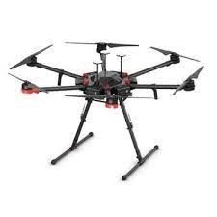
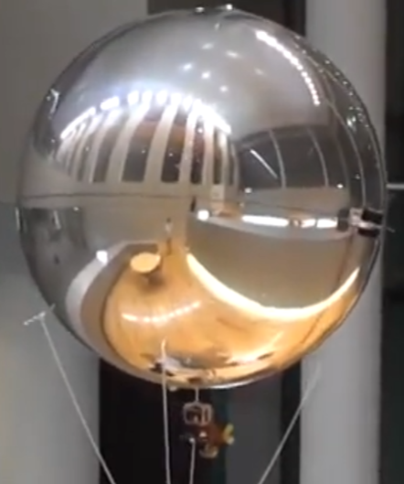
Current Solutions
DJI Matrice 600 Pro
Huge battery, still limited to 15 minute flights
High cost of $6600
Motors can cause magnetic interference for payload
ZeRONE
Weak motor uses ultrasonic propulsion, cannot carry heavy sensors other than a small camera
Uncontrollable under light wind conditions, not suitable for outdoor use

Slide 4
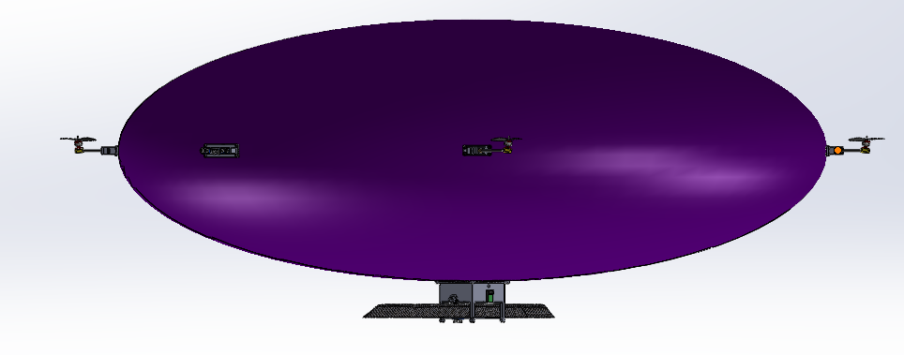
Our Solution
Buoyant Drone aka Barone
Takes advantage of natural buoyancy of helium
Less weight means less power required to hover and move around, which means longer flight time with same power
Lower reliance on motors means less potential interference for payloads logging data
Can fly in up to 15 mph winds

Slide 5
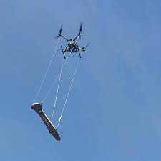
Applications
United States Geological Survey (USGS)
Aerial data collection surveys to map the magnetic field in an area
Reducing batteries needed to conduct surveys
Other Applications
UXO detection
Remote area networks
Notes:
Our Solution could greatly help data collection in large scale surveys
for example Researchers at the United States Geological Survey are collecting data on the earth’s magnetic field.
This can provide them with valuable information on geologic faults and anomalies such as geysers.
In order to collect this data they currently use the DJI Matrice 600 Pro with an attached magnetometer that makes 7 consecutive 15 minute flights in order to conduct just one survey
Our Drone could reduce this too 1 or 2 flights averaging around 40 minutes each, not only would this save time, but it would also save money from not needing multiple expensive replacement batteries which can cost hundreds of dollars a piece.
Our drone could also use a magnetometer for finding unexploded ordnance in war torn areas or routers and satellites, attached to multiple drones could be deployed to set up a networks in remote areas.

Slide 6
Questions?
Notes:
After this presentation we hope that you can see the many potential benefits and applications of our project, The Barone.

